Slide 1
Regression_scikit learn

Slide 2
Scikit-Learn

Slide 3
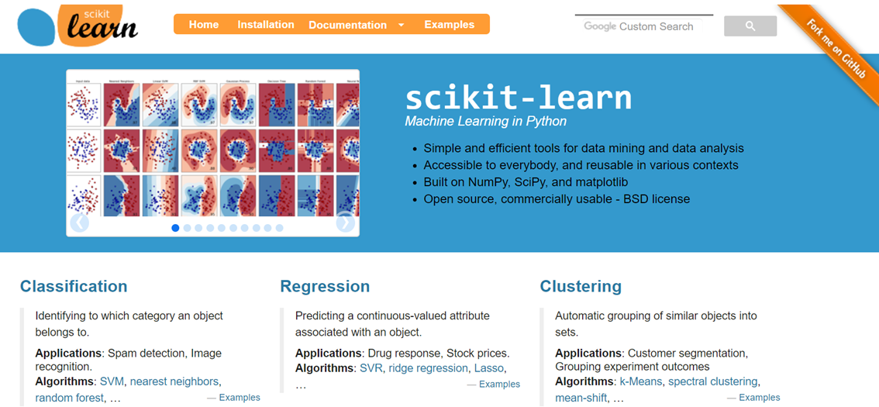
https://scikit-learn.org/stable/

Slide 4
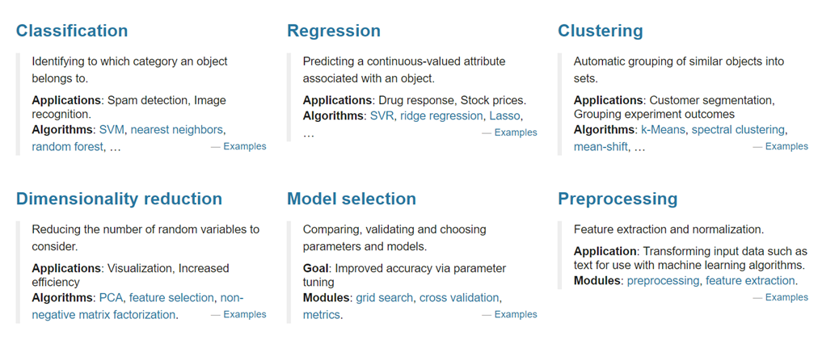
https://scikit-learn.org/stable/

Slide 5
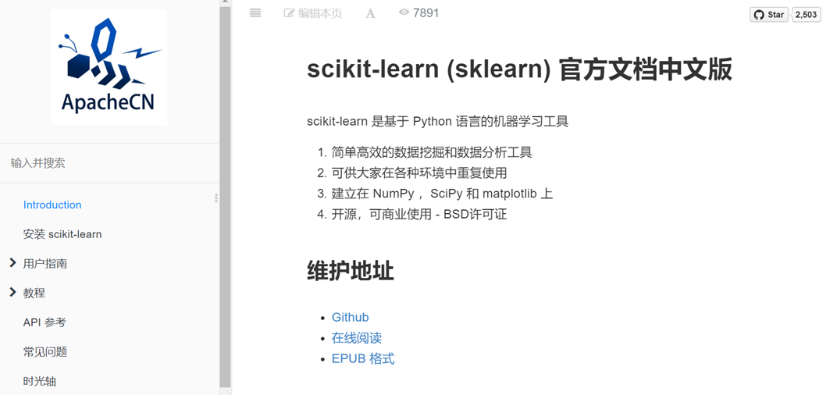
https://sklearn.apachecn.org/docs/0.21.3/

Slide 6
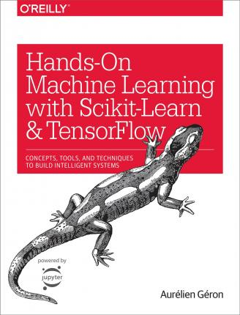
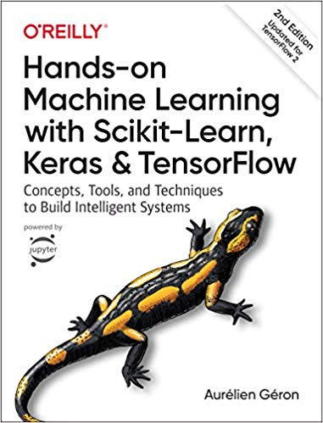
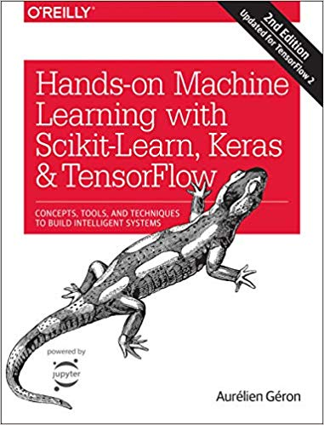
推薦教科書
https://www.tenlong.com.tw/products/9787111603023
2019-10-04
https://github.com/ageron/handson-ml
https://github.com/ageron/handson-ml2

Slide 7

推薦教科書
Chapter01 機器學習介紹
Chapter02 Python 機器學習軟體套件
Chapter03 機器學習理論基礎
3.1 過擬合和欠擬合
3.2 成本函數
3.3 模型準確性
3.4 學習曲線
3.5 演算法模型效能最佳化
3.6 查準率和召回率
3.7 F1 Score
Chapter04 k- 近鄰演算法
4.1 演算法原理
4.2 範例：使用k- 近鄰演算法進行分類
4.3 範例：使用k- 近鄰演算法進行回歸擬合
4.4 實例：糖尿病預測
Chapter05 線性回歸演算法
5.1 演算法原理
5.2 多變數線性回歸演算法
5.3 模型最佳化
5.4 範例：使用線性回歸演算法擬合正弦函數
5.5 範例：測算房價
Chapter06 邏輯回歸演算法
6.1 演算法原理
6.2 多元分類
6.3 正規化
6.4 演算法參數
6.5 實例：乳腺癌檢測
Chapter07 決策樹
7.1 演算法原理
7.2 演算法參數
7.3 實例：預測鐵達尼號倖存者
7.4 擴充閱讀
7.5 集合演算法
Chapter08 支援向量機
8.1 演算法原理
8.2 核心函數
8.3 scikit-learn 裡的
8.4 實例：乳腺癌檢測
Chapter09 單純貝氏演算法
9.1 演算法原理
9.2 一個簡單的實例
9.3 機率分佈
9.4 連續值的處理
9.5 實例：文件分類
Chapter10 PCA 演算法
10.1 演算法原理
10.2 PCA 演算法範例
10.3 PCA 的資料還原率及應用
10.4 實例：人臉識別
Chapter11 k- 平均值演算法
11.1 演算法原理
11.2 scikit-learn 裡的k- 平均值演算法
11.3 使用k- 平均值對文件進行分群分析
11.4 分群演算法效能評估
打下最紮實的AI基礎：
從scikit-learn一步一腳印
作者： 黄永昌
出版社：佳魁資訊
出版日期：2019/03/18

Slide 8
Scikit-Learn
regression

Slide 9
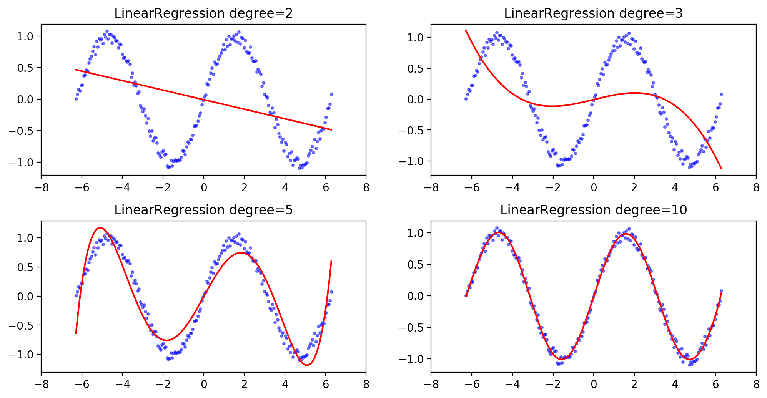
範例 使用線性回歸演算法擬合正弦函數

Slide 10
%matplotlib inline
import matplotlib.pyplot as plt
import numpy as np
n_dots = 200
X = np.linspace(-2 * np.pi, 2 * np.pi, n_dots)
Y = np.sin(X) + 0.2 * np.random.rand(n_dots) - 0.1
X = X.reshape(-1, 1)
Y = Y.reshape(-1, 1);

Slide 11
from sklearn.linear_model import LinearRegression
from sklearn.preprocessing import PolynomialFeatures
from sklearn.pipeline import Pipeline
def polynomial_model(degree=1):
polynomial_features = PolynomialFeatures(degree=degree,
include_bias=False)
linear_regression = LinearRegression(normalize=True)
pipeline = Pipeline([("polynomial_features", polynomial_features),
("linear_regression", linear_regression)])
return pipeline

Slide 12
from sklearn.metrics import mean_squared_error
degrees = [2, 3, 5, 10]
results = []
for d in degrees:
model = polynomial_model(degree=d)
model.fit(X, Y)
train_score = model.score(X, Y)
mse = mean_squared_error(Y, model.predict(X))
results.append({"model": model, "degree": d, "score": train_score, "mse": mse})
for r in results:
print("degree: {}; train score: {}; mean squared error: {}".format(r["degree"], r["score"], r["mse"]))

Slide 13
degree: 2; train score: 0.15120130853311653; mean squared error: 0.42919617521827297
degree: 3; train score: 0.273079807598105; mean squared error: 0.3675681517942078
degree: 5; train score: 0.8986924862180984; mean squared error: 0.05122627764767362
degree: 10; train score: 0.9933633433178839; mean squared error: 0.0033558341840494834

Slide 14
from matplotlib.figure import SubplotParams
plt.figure(figsize=(12, 6), dpi=200, subplotpars=SubplotParams(hspace=0.3))
for i, r in enumerate(results):
fig = plt.subplot(2, 2, i+1)
plt.xlim(-8, 8)
plt.title("LinearRegression degree={}".format(r["degree"]))
plt.scatter(X, Y, s=5, c='b', alpha=0.5)
plt.plot(X, r["model"].predict(X), 'r-')

Slide 15
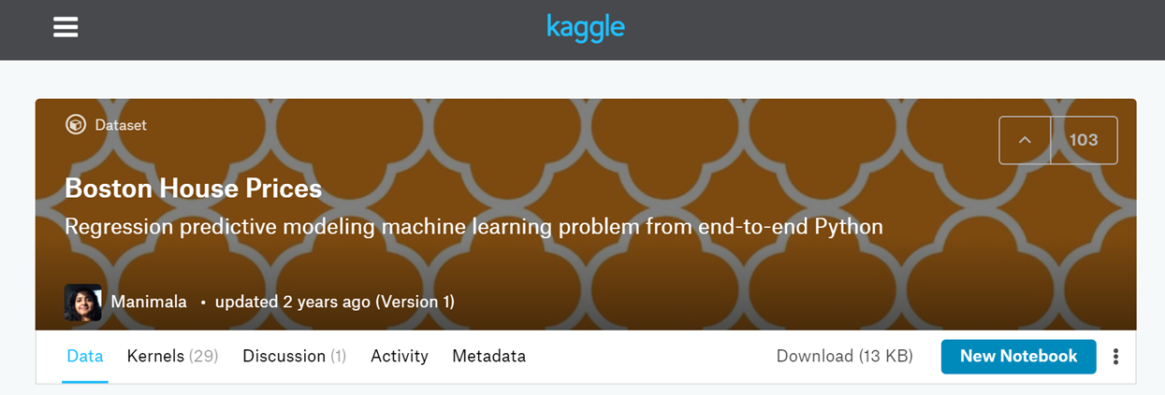
Boston House Prices
範例分析
波士頓房屋售價預測
https://www.kaggle.com/vikrishnan/boston-house-prices

Slide 16
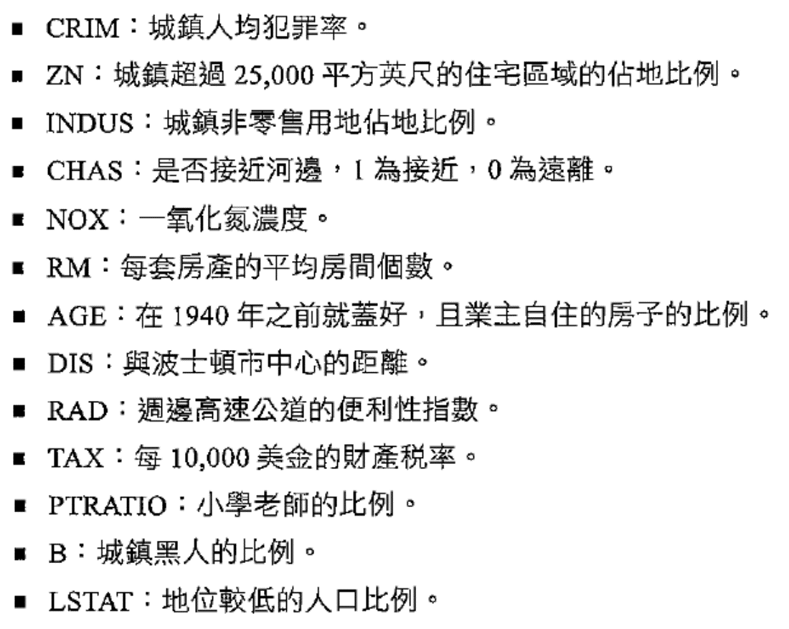

Slide 17
%matplotlib inline
import matplotlib.pyplot as plt
import numpy as np

Slide 18
from sklearn.datasets import load_boston
boston = load_boston()
X = boston.data
y = boston.target
X.shape
X[0]
boston.feature_names

Slide 19
from sklearn.model_selection import train_test_split
X_train, X_test, y_train, y_test =
train_test_split(X, y, test_size=0.2, random_state=3)

Slide 20
import time
from sklearn.linear_model import LinearRegression
model = LinearRegression()
start = time.clock()
model.fit(X_train, y_train)
train_score = model.score(X_train, y_train)
cv_score = model.score(X_test, y_test)
print('elaspe: {0:.6f}; train_score: {1:0.6f}; cv_score: {2:.6f}'.format(time.clock()-start, train_score, cv_score))
elaspe: 0.004027; train_score: 0.723941; cv_score: 0.795262

Slide 21
from sklearn.linear_model import LinearRegression
from sklearn.preprocessing import PolynomialFeatures
from sklearn.pipeline import Pipeline
def polynomial_model(degree=1):
polynomial_features = PolynomialFeatures(degree=degree,
include_bias=False)
linear_regression = LinearRegression(normalize=True)
pipeline = Pipeline([("polynomial_features", polynomial_features),
("linear_regression", linear_regression)])
return pipeline
model = polynomial_model(degree=2)
start = time.clock()
model.fit(X_train, y_train)
train_score = model.score(X_train, y_train)
cv_score = model.score(X_test, y_test)
print('elaspe: {0:.6f}; train_score: {1:0.6f}; cv_score: {2:.6f}'.format(time.clock()-start, train_score, cv_score))
elaspe: 0.030501; train_score: 0.930547; cv_score: 0.860049

Slide 22
from sklearn.model_selection import learning_curve
import numpy as np
def plot_learning_curve(plt, estimator, title, X, y, ylim=None, cv=None,
n_jobs=1, train_sizes=np.linspace(.1, 1.0, 5)):
plt.title(title)
if ylim is not None:
plt.ylim(*ylim)
plt.xlabel("Training examples")
plt.ylabel("Score")
train_sizes, train_scores, test_scores = learning_curve(
estimator, X, y, cv=cv, n_jobs=n_jobs, train_sizes=train_sizes)
train_scores_mean = np.mean(train_scores, axis=1)
train_scores_std = np.std(train_scores, axis=1)
test_scores_mean = np.mean(test_scores, axis=1)
test_scores_std = np.std(test_scores, axis=1)
plt.grid()
plt.fill_between(train_sizes, train_scores_mean - train_scores_std,
train_scores_mean + train_scores_std, alpha=0.1,
color="r")
plt.fill_between(train_sizes, test_scores_mean - test_scores_std,
test_scores_mean + test_scores_std, alpha=0.1, color="g")
plt.plot(train_sizes, train_scores_mean, 'o--', color="r",
label="Training score")
plt.plot(train_sizes, test_scores_mean, 'o-', color="g",
label="Cross-validation score")
plt.legend(loc="best")
return plt

Slide 23
"""
Generate a simple plot of the test and training learning curve.
Parameters
----------
estimator : object type that implements the "fit" and "predict" methods
An object of that type which is cloned for each validation.
title : string
Title for the chart.
X : array-like, shape (n_samples, n_features)
Training vector, where n_samples is the number of samples and
n_features is the number of features.
y : array-like, shape (n_samples) or (n_samples, n_features), optional
Target relative to X for classification or regression;
None for unsupervised learning.
ylim : tuple, shape (ymin, ymax), optional
Defines minimum and maximum yvalues plotted.
cv : int, cross-validation generator or an iterable, optional
Determines the cross-validation splitting strategy.
Possible inputs for cv are:
- None, to use the default 3-fold cross-validation,
- integer, to specify the number of folds.
- An object to be used as a cross-validation generator.
- An iterable yielding train/test splits.
For integer/None inputs, if ``y`` is binary or multiclass,
:class:`StratifiedKFold` used. If the estimator is not a classifier
or if ``y`` is neither binary nor multiclass, :class:`KFold` is used.
Refer :ref:`User Guide <cross_validation>` for the various
cross-validators that can be used here.
n_jobs : integer, optional
Number of jobs to run in parallel (default 1).
"""

Slide 24
from sklearn.model_selection import ShuffleSplit
cv = ShuffleSplit(n_splits=10, test_size=0.2, random_state=0)
plt.figure(figsize=(18, 4))
title = 'Learning Curves (degree={0})'
degrees = [1, 2, 3]
start = time.clock()
plt.figure(figsize=(18, 4), dpi=200)
for i in range(len(degrees)):
plt.subplot(1, 3, i + 1)
plot_learning_curve(plt, polynomial_model(degrees[i]), title.format(degrees[i]), X, y, ylim=(0.01, 1.01), cv=cv)
print('elaspe: {0:.6f}'.format(time.clock()-start))

Slide 25
K-fold交叉驗證
當樣本資料量比較小時，K-fold交叉驗證是訓練、評價模型時的常用方法
該方法的作用如下：
交叉驗證用於評估模型的預測性能，尤其是訓練好的模型在新資料上的表現，可以在一定程度上減小過擬合
交叉驗證可以從有限的資料中獲取盡可能多的有效資訊
sklearn的可用於K-fold交叉驗證的集合劃分類ShuffleSplit、GroupShuffleSplit
https://blog.csdn.net/hurry0808/article/details/80797969

Slide 26
class sklearn.model_selection.ShuffleSplit
(n_splits=10, test_size=’default’, train_size=None, random_state=None)
n_splits:int, 劃分訓練集、測試集的次數，預設為10
test_size:float, int, None, default=0.1；
測試集比例或樣本數量，
該值為[0.0, 1.0]內的浮點數時，表示測試集占總樣本的比例；
該值為整型值時，表示具體的測試集樣本數量；
train_size不設定具體數值時，該值取預設值0.1，
train_size設定具體數值時，test_size取剩餘部分train_size:float, int, None； 訓練集比例或樣本數量，該值為[0.0, 1.0]內的浮點數時，表示訓練集占總樣本的比例；該值為整型值時，表示具體的訓練集樣本數量；該值為None(預設值)時，訓練集取總體樣本除去測試集的部分
Random_state:int, RandomState instance or None；隨機種子值，默認為None
https://blog.csdn.net/hurry0808/article/details/80797969

Slide 27
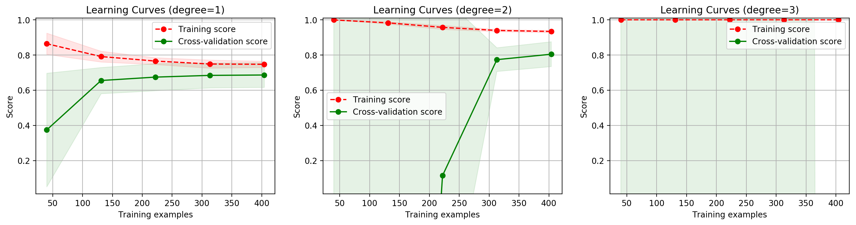

Slide 28
Scikit-Learn
KNN Regression
sklearn.neighbors.KNeighborsRegressor
https://scikit-learn.org/stable/modules/generated/sklearn.neighbors.KNeighborsRegressor.html

Slide 29
KNeighborsRegressor
%matplotlib inline
import matplotlib.pyplot as plt
import numpy as np
# 生成訓練樣本
n_dots = 40
X = 5 * np.random.rand(n_dots, 1)
y = np.cos(X).ravel()
# 添加一些雜訊
y += 0.2 * np.random.rand(n_dots) - 0.1

Slide 30
# 訓練模型
from sklearn.neighbors import KNeighborsRegressor
k = 5
knn = KNeighborsRegressor(k)
knn.fit(X, y);

Slide 31
# 生成足夠密集的點並進行預測
T = np.linspace(0, 5, 500)[:, np.newaxis]
y_pred = knn.predict(T)
knn.score(X, y)
0.9823932837572384

Slide 32
# 畫出擬合曲線
plt.figure(figsize=(16, 10))
plt.scatter(X, y, c='g', label='data', s=100) # 畫出訓練樣本
plt.plot(T, y_pred, c='k', label='prediction', lw=4) # 畫出擬合曲線
plt.axis('tight')
plt.title("KNeighborsRegressor (k = %i)" % k)
plt.show()

Slide 33
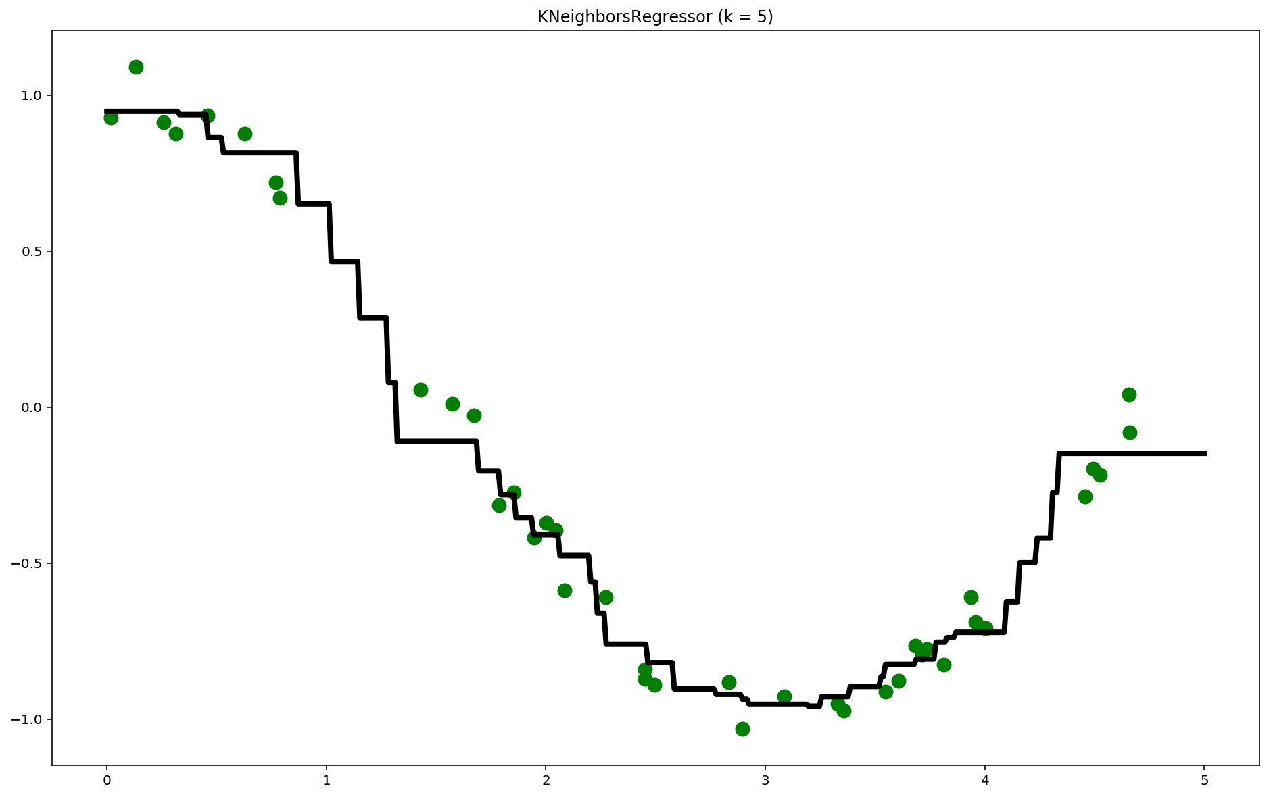

Slide 34
回歸問題的評估方法
https://zhuanlan.zhihu.com/p/37663120
https://zhuanlan.zhihu.com/p/44094614
https://zhuanlan.zhihu.com/p/61341071

Slide 35
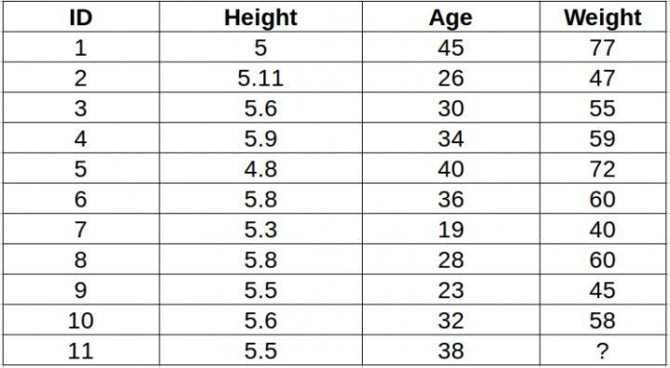

Slide 36
Scikit-Learn
Regression
https://zhuanlan.zhihu.com/p/37663120

Slide 37
使用sklearn做各種回歸
基本回歸：線性、決策樹、SVM、KNN
集成方法：隨機森林、Adaboost、GradientBoosting、Bagging、ExtraTrees
https://blog.csdn.net/Yeoman92/article/details/75051848
####3.1決策樹回歸####
from sklearn import tree
model_DecisionTreeRegressor = tree.DecisionTreeRegressor()
####3.2線性回歸####
from sklearn import linear_model
model_LinearRegression = linear_model.LinearRegression()
####3.3SVM回歸####
from sklearn import svm
model_SVR = svm.SVR()
####3.4KNN回歸####
from sklearn import neighbors
model_KNeighborsRegressor = neighbors.KNeighborsRegressor()
####3.5隨機森林回歸####
from sklearn import ensemble
model_RandomForestRegressor = ensemble.RandomForestRegressor(n_estimators=20)#這裡使用20個決策樹
####3.6Adaboost回歸####
from sklearn import ensemble
model_AdaBoostRegressor = ensemble.AdaBoostRegressor(n_estimators=50)#這裡使用50個決策樹
####3.7GBRT回歸####
from sklearn import ensemble
model_GradientBoostingRegressor = ensemble.GradientBoostingRegressor(n_estimators=100)#這裡使用100個決策樹
####3.8Bagging回歸####
from sklearn.ensemble import BaggingRegressor
model_BaggingRegressor = BaggingRegressor()
####3.9ExtraTree極端隨機樹回歸####
from sklearn.tree import ExtraTreeRegressor
model_ExtraTreeRegressor = ExtraTreeRegressor()

Slide 38
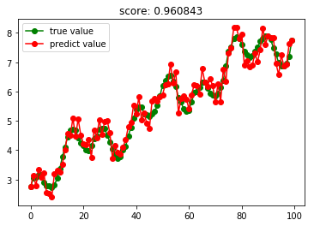

Slide 39
Scikit-Learn
Decision Tree Regression
sklearn.tree.DecisionTreeRegressor
https://scikit-learn.org/stable/modules/generated/sklearn.tree.DecisionTreeRegressor.html

Slide 40
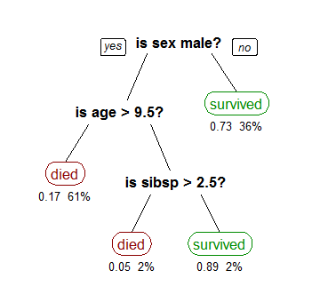
決策樹
https://zh.wikipedia.org/wiki/決策樹學習
描述鐵達尼號上乘客生存的決策樹
("sibsp"指甲板上的兄妹和配偶)。
每個決策葉下標識該類乘客的生存機率和觀察到的比率

Slide 41
決策樹的優缺點
決策樹的優點::與其他的數據挖掘算法相比，決策樹有許多優點:
易於理解和解釋 人們很容易理解決策樹的意義。
只需很少的數據準備 其他技術往往需要數據歸一化。
即可以處理數值型數據也可以處理類別型 數據。其他技術往往只能處理一種數據類型。例如關聯規則只能處理類別型的而神經網絡只能處理數值型的數據。
使用白箱 模型. 輸出結果容易通過模型的結構來解釋。而神經網絡是黑箱模型，很難解釋輸出的結果。
可以通過測試集來驗證模型的性能 。可以考慮模型的穩定性。
強健控制. 對噪聲處理有好的強健性。
可以很好的處理大規模數據 。
缺點
訓練一棵最優的決策樹是一個完全NP問題 NP-complete。 因此, 實際應用時決策樹的訓練採用啟發式搜索算法例如 貪心算法 來達到局部最優。這樣的算法沒辦法得到最優的決策樹。
決策樹創建的過度複雜會導致無法很好的預測訓練集之外的數據。這稱作過擬合.剪枝機制可以避免這種問題。
有些問題決策樹沒辦法很好的解決,例如 Exclusive or問題。解決這種問題的時候，決策樹會變得過大。 要解決這種問題，只能改變問題的領域[13] 或者使用其他更為耗時的學習算法 (例如統計關係學習 或者 歸納邏輯編程).
對那些有類別型屬性的數據, 信息增益 會有一定的偏置

Slide 42
Decision tree learning
Decision tree learning is the construction of a decision tree from class-labeled training tuples. A decision tree is a flow-chart-like structure, where each internal (non-leaf) node denotes a test on an attribute, each branch represents the outcome of a test, and each leaf (or terminal) node holds a class label. The topmost node in a tree is the root node.
There are many specific decision-tree algorithms. Notable ones include:
ID3 (Iterative Dichotomiser 3)
C4.5 (successor of ID3)
CART (Classification And Regression Tree)
Chi-square automatic interaction detection (CHAID). Performs multi-level splits when computing classification trees.
MARS: extends decision trees to handle numerical data better.
Conditional Inference Trees. Statistics-based approach that uses non-parametric tests as splitting criteria, corrected for multiple testing to avoid overfitting. This approach results in unbiased predictor selection and does not require pruning.

Slide 43
決策樹的類型
決策樹主要有兩種類型:
分類樹 的輸出是樣本的類標。
回歸樹 的輸出是一個實數 (例如房子的價格，病人待在醫院的時間等)。
術語分類和回歸樹 (CART) 包含了上述兩種決策樹, 最先由Breiman 等提出.
分類樹和回歸樹有些共同點和不同點—例如處理在何處分裂的問題。
有些集成的方法產生多棵樹：
裝袋算法（Bagging）, 是一個早期的集成方法，用有放回抽樣法來訓練多棵決策樹，最終結果用投票法產生。
隨機森林（Random Forest） 使用多棵決策樹來改進分類性能。
提升樹（Boosting Tree） 可以用來做回歸分析和分類決策[4][5]
旋轉森林（Rotation forest） – 每棵樹的訓練首先使用主元分析法 (PCA)

Slide 44
Classification And Regression Tree (CART)[1984]
Breiman, Leo; Friedman, J. H., Olshen, R. A., & Stone, C. J. Classification and regression trees. Monterey, CA: Wadsworth & Brooks/Cole Advanced Books & Software. 1984. ISBN 978-0-412-04841-8.

Slide 45
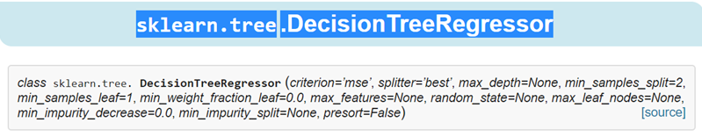
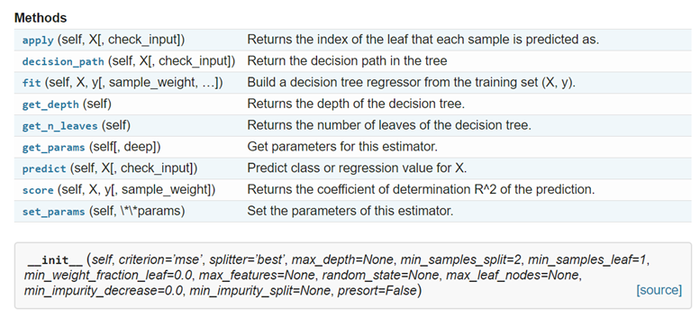
https://scikit-learn.org/stable/modules/generated/sklearn.tree.DecisionTreeRegressor.html

Slide 46
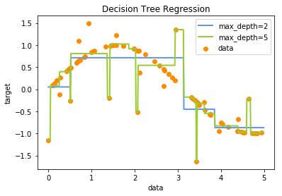
決策樹回歸分析 Decision Tree Regression
決策樹Decision Tree 常用在分類
但決策樹Decision Tree 也可用在回歸分析
https://machine-learning-python.kspax.io/decision_trees/ex1_decision_tree_regression

Slide 47
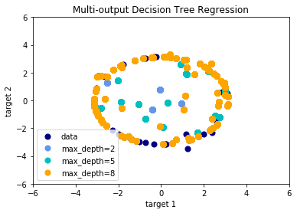
Multi-output Decision Tree Regression
https://machine-learning-python.kspax.io/decision_trees/ex2_multi-output_decision_tree_regression

Slide 48
Scikit-Learn
sklearn.svm.SVR

Slide 49
There are three different implementations of Support Vector Regression: SVR, NuSVR and LinearSVR.
LinearSVR provides a faster implementation than SVR but only considers linear kernels, while NuSVR implements a slightly different formulation than SVR and LinearSVR

Slide 50
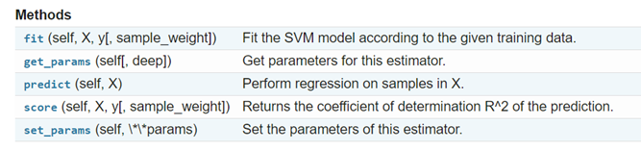
sklearn.svm.SVR
https://scikit-learn.org/stable/modules/generated/sklearn.svm.SVR.html#sklearn.svm.SVR
class sklearn.svm.SVR( kernel=’rbf’, degree=3, gamma=’auto_deprecated’, coef0=0.0, tol=0.001, C=1.0, epsilon=0.1, shrinking=True, cache_size=200, verbose=False, max_iter=-1)

Slide 51
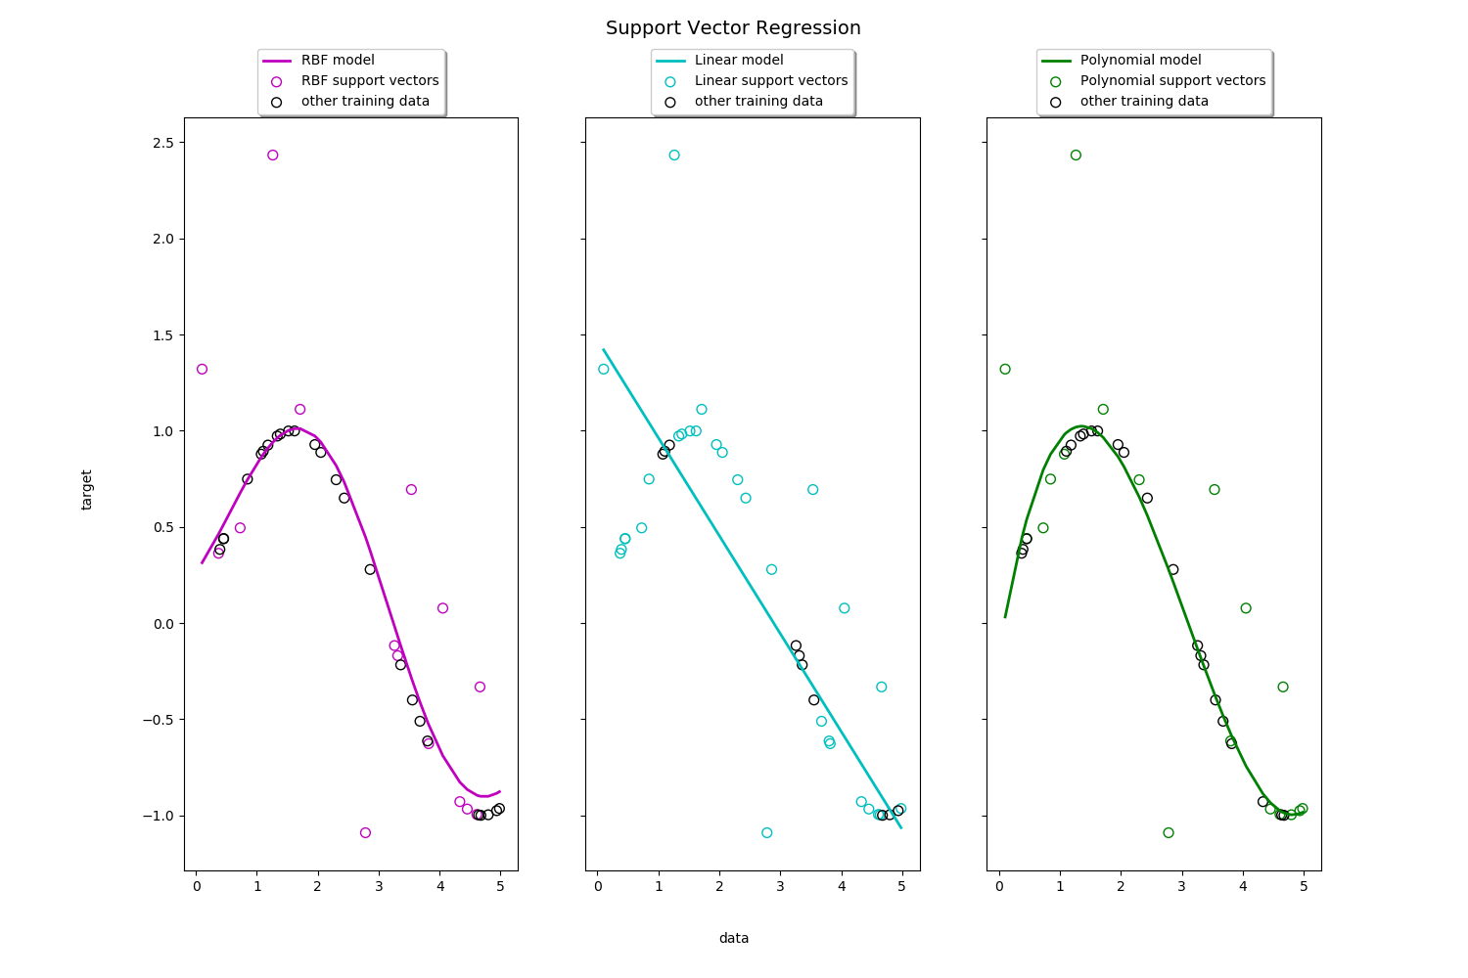
https://scikit-learn.org/stable/auto_examples/svm/plot_svm_regression.html#sphx-glr-auto-examples-svm-plot-svm-regression-py
Toy example of 1D regression using linear, polynomial and RBF kernels.

Slide 52
import numpy as np
from sklearn.svm import SVR
import matplotlib.pyplot as plt
# Fit regression model
svr_rbf = SVR(kernel='rbf', C=100, gamma=0.1, epsilon=.1)
svr_lin = SVR(kernel='linear', C=100, gamma='auto')
svr_poly = SVR(kernel='poly', C=100, gamma='auto', degree=3, epsilon=.1,
coef0=1)
https://scikit-learn.org/stable/auto_examples/svm/plot_svm_regression.html#sphx-glr-auto-examples-svm-plot-svm-regression-py

Slide 53
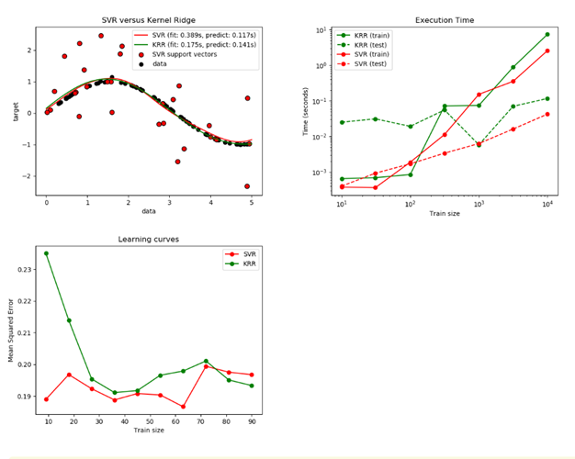
Comparison of kernel ridge regression and SVR
https://scikit-learn.org/stable/auto_examples/plot_kernel_ridge_regression.html#sphx-glr-auto-examples-plot-kernel-ridge-regression-py

Slide 54
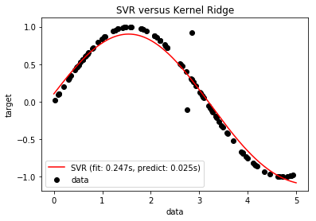

Slide 55
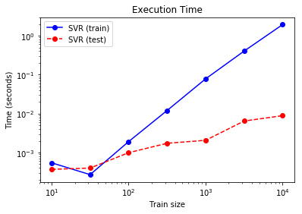

Slide 56
